Slide 1


SPOTIFY VS. YOUTUBE

Slide 2
What Factors Influence The
Success Of A Song?

Slide 3
How We Approached It
01
02
Understand Dataset
Cleaning
03
04
Perform Analysis
Draw Conclusions

Slide 4
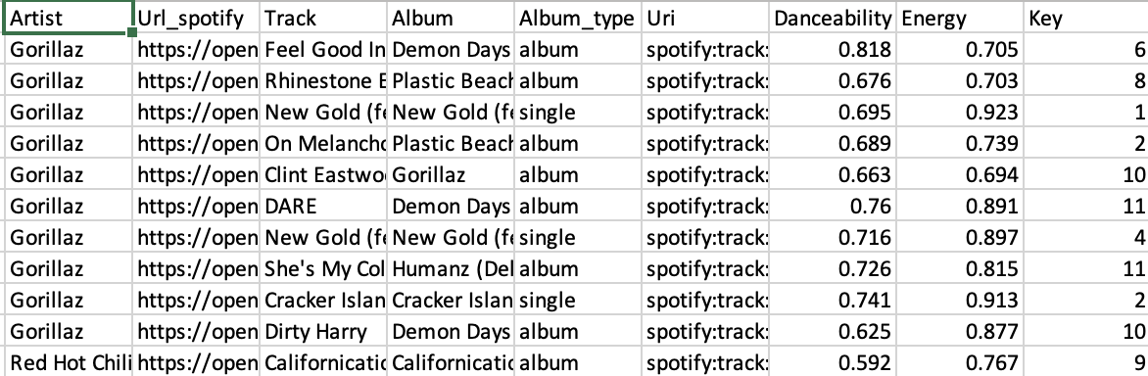
Data Set

Slide 5
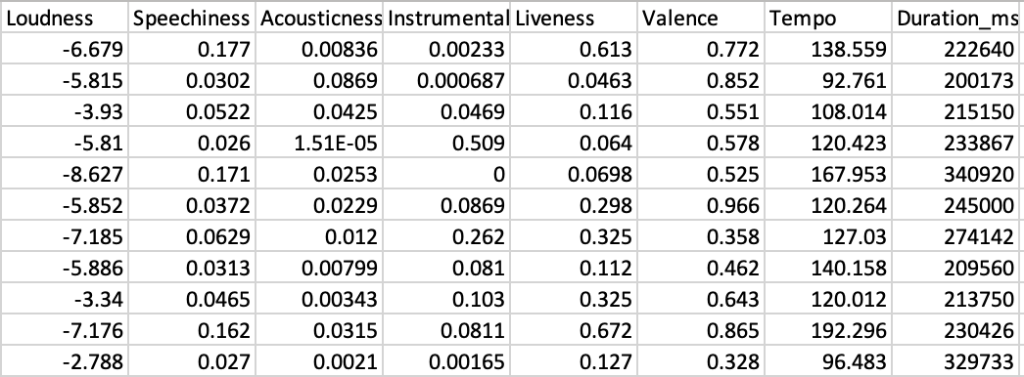
Data Set

Slide 6
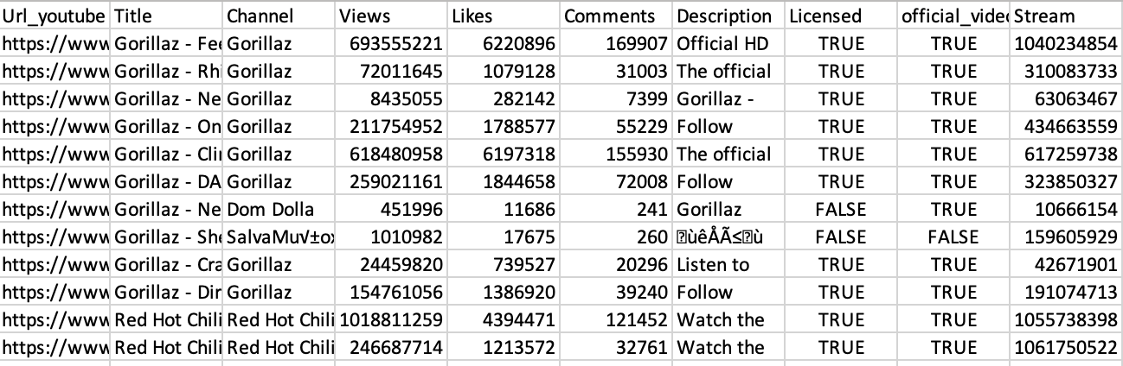
Data Set

Slide 7
Understanding Success

Slide 8
Understanding Success
Spotify Streams

Slide 9
Understanding Success
Spotify Streams
+

Slide 10
Understanding Success
Spotify Streams
+
YouTube Views

Slide 11
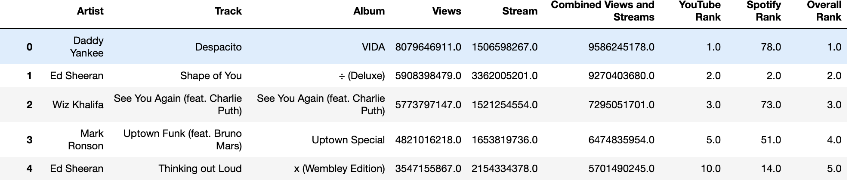
Understanding Success
Spotify Streams
+
YouTube Views
= Overall Success/Rank

Slide 12
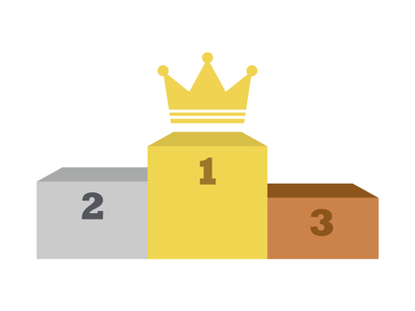


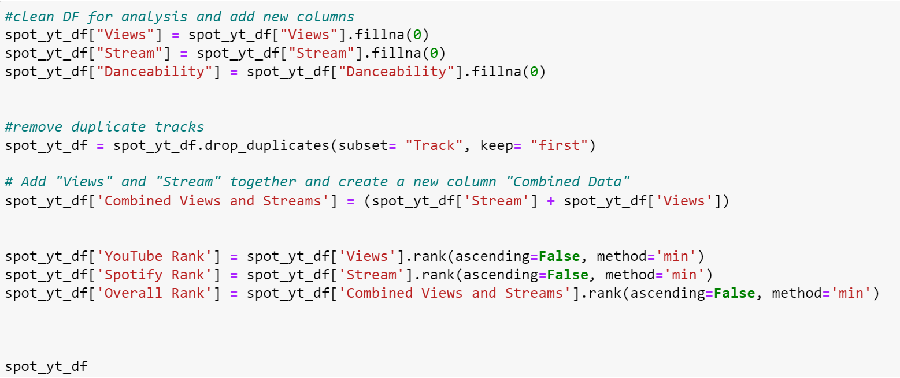
Cleaning The Data
Notes:
We decided our measure of success for most streams and views combined
To do so we needed to change any N/A values to 0
Then from there we decided to rank the songs by views, streams, and combined views and streams
As we drove further into our analysis the data needed to be cleaned more from a visual standpoint. Top ranked songs were showing up as duplicates if there were multiple artists on the track. Despacity by Luis Fonsi and Despacity by Daddy Yanky.

Slide 13
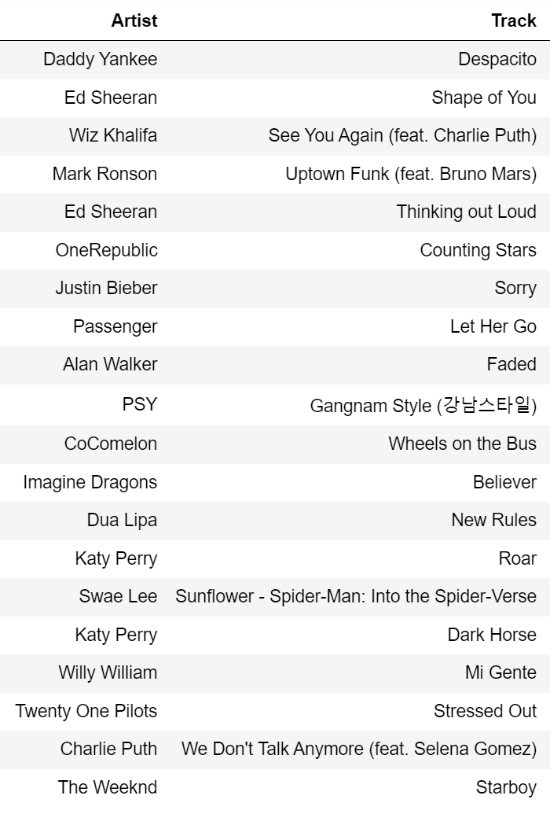
Streams vs. Views
Top 20 Songs for Combined Views and Streams
Which 2 Songs Made it on the Top 20 for Spotify and YouTube?

Slide 14
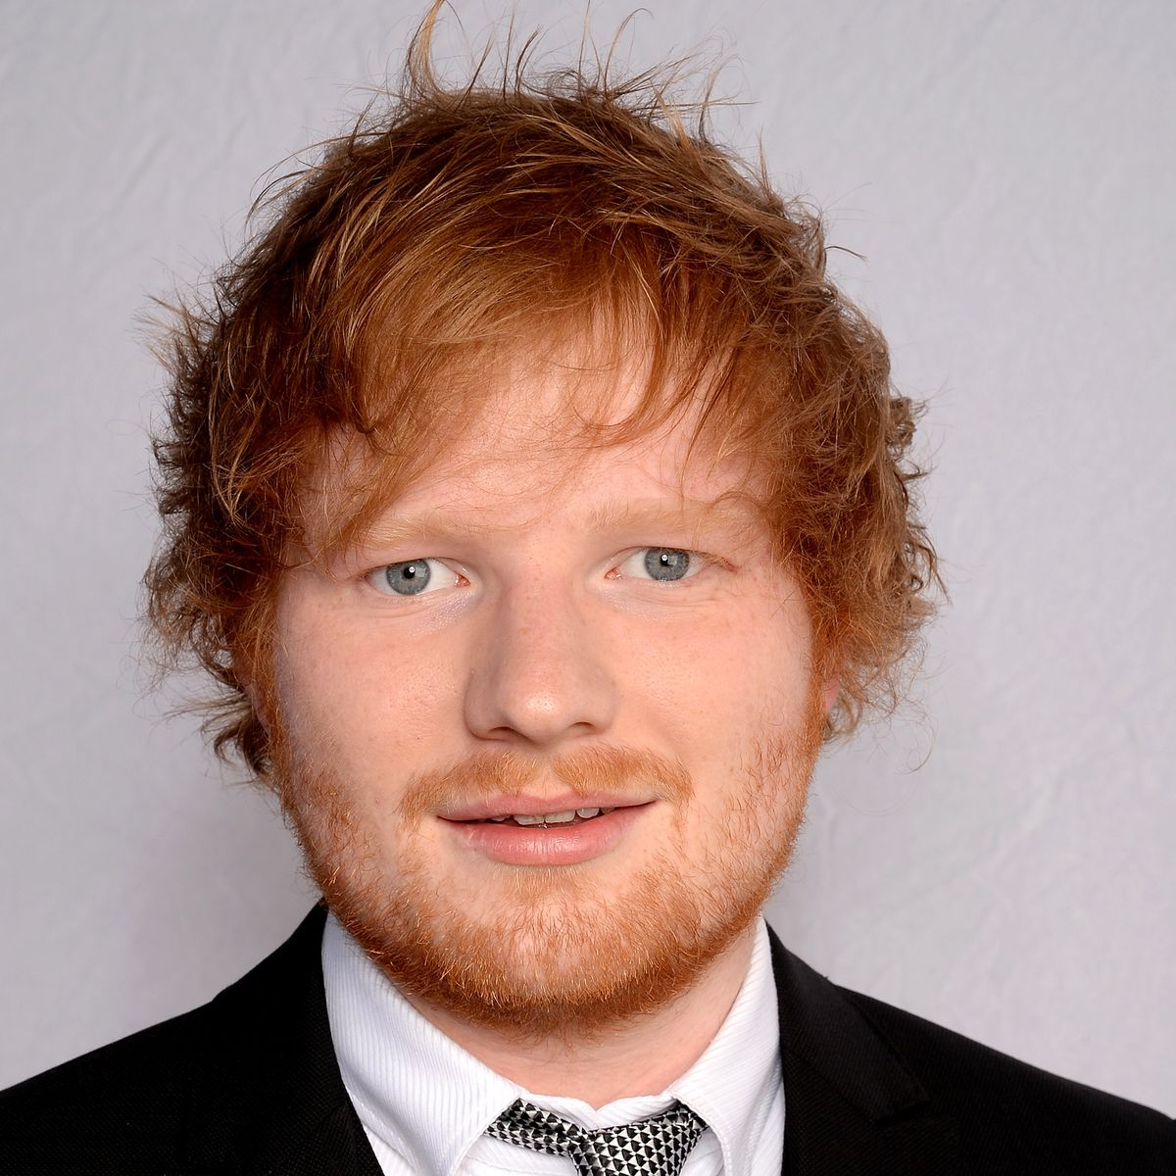
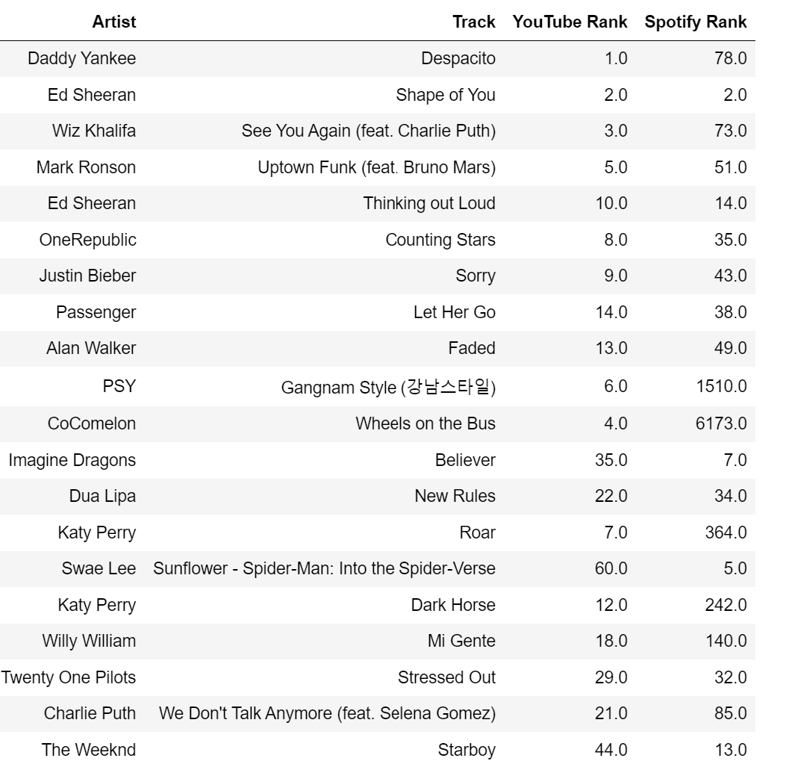
Streams vs. Views
Only Artist In Top 20 on YouTube and Spotify:
Ed Sheeran
Shape of You
Thinking Out Loud

Slide 15
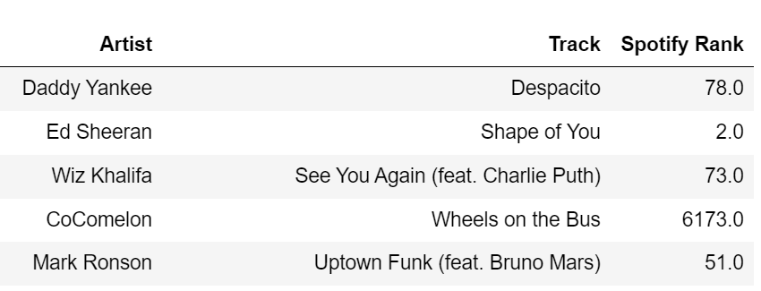
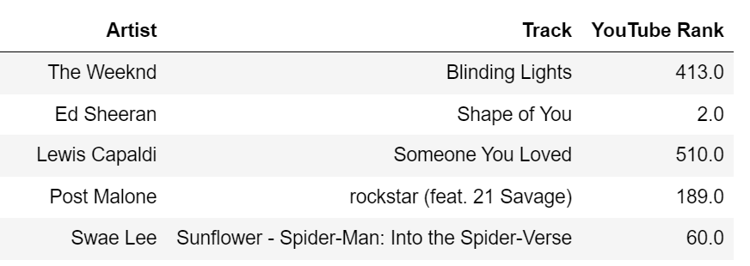
Correlation of
Streams and Views
Top 5 YouTube Songs
Top 5 Spotify Songs

Slide 16
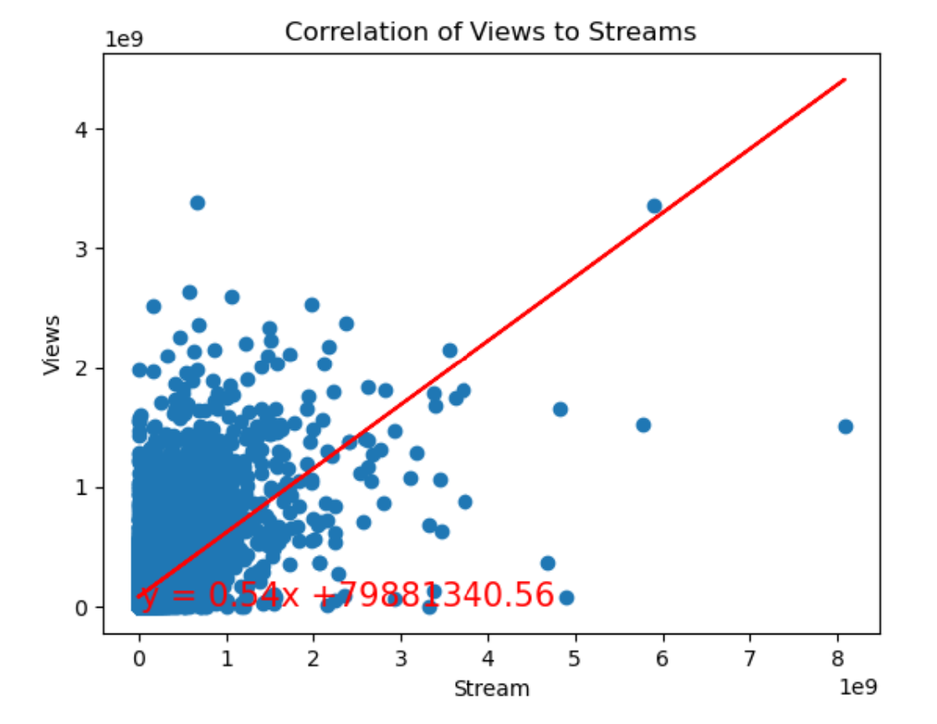
Linear Regression
Streams and views may be a little correlated with the slope of the trend but has a lower r-value so not heavily
R-Value: .34
Slope: .54

Slide 17
Danceability To Overall Success
Does danceability have an effect on overall success?

Slide 18
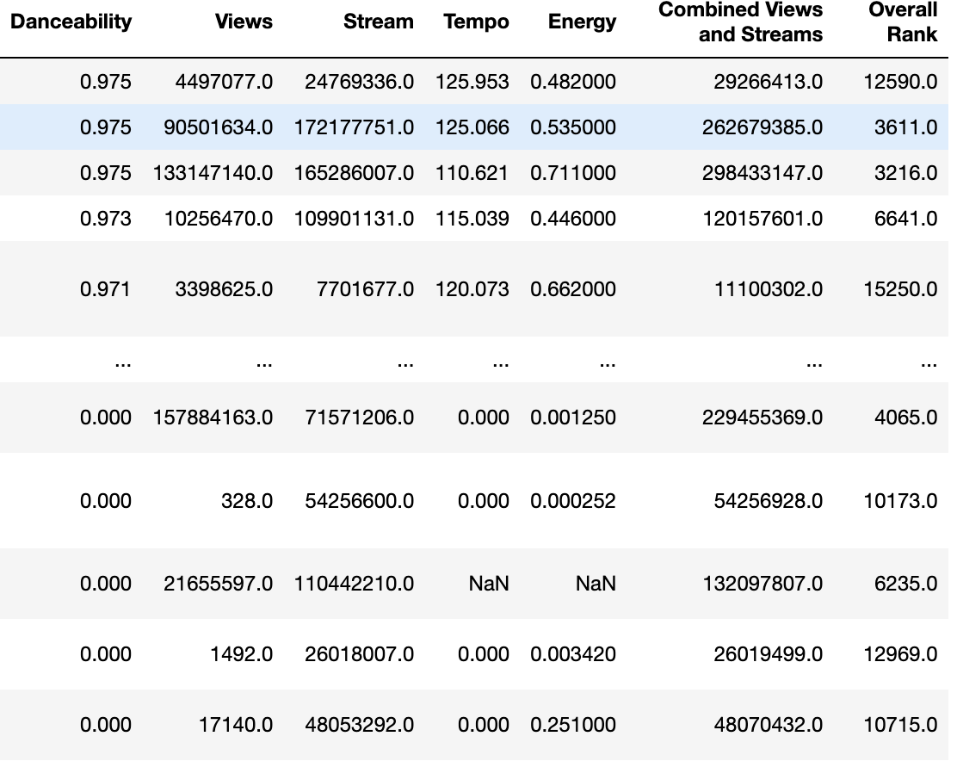

Slide 19
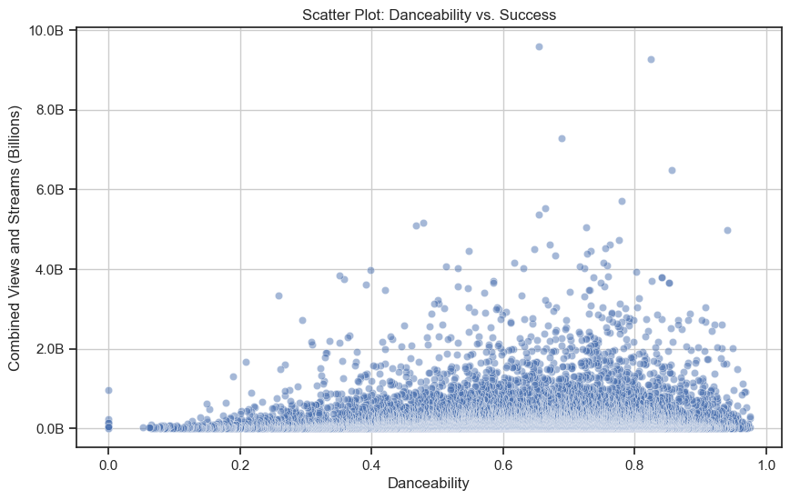

Slide 20
Danceability To Overall Success
Are there any other correlations?

Slide 23
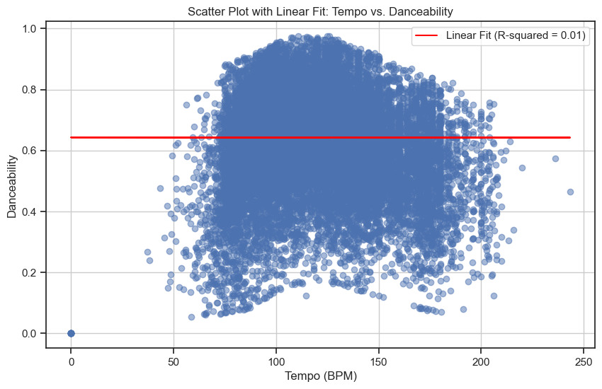

Slide 26
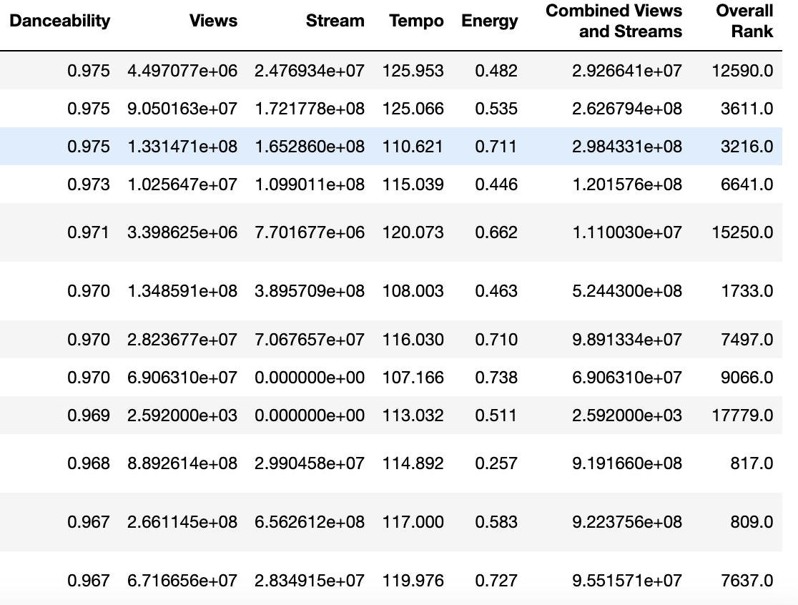

Slide 27
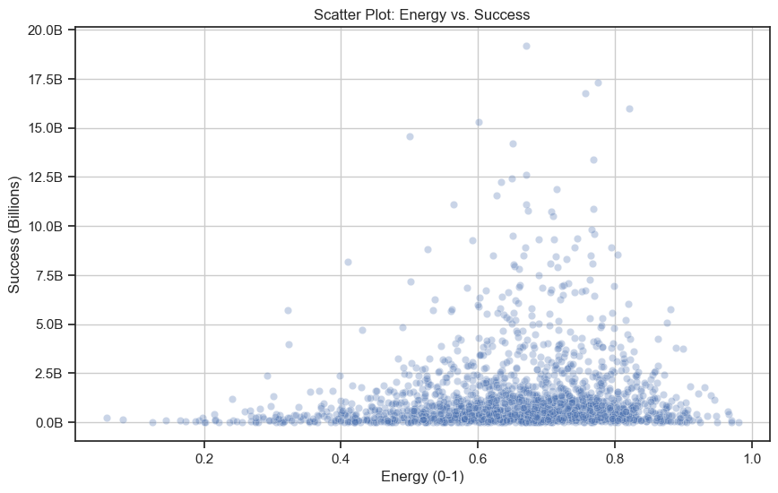

Slide 28
Danceability To Overall Success
What does all this mean?

Slide 30
Top 10 Albums
What are the top ten albums from this dataset,
based on the combined Spotify Streams & YouTube views?
This data set is organized by individual song tracks, not albums.
We removed the duplicates & grouped the data by albums
Created a bar chart visualization.

Slide 31
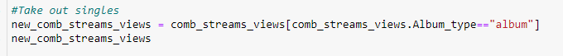
Top 10 Albums: Python Panda Methods
First, create album dataframe from the clean dataframe:
Take out the singles:
Group the songs by album using groupby & sort them by “Combined Views and Streams”:

Slide 32
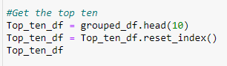
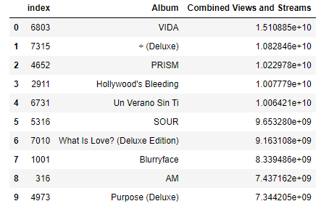
Top 10 Albums: Python Panda Methods
Get the top 10:
Table output:

Slide 33
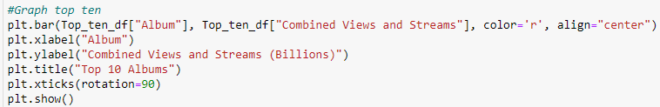
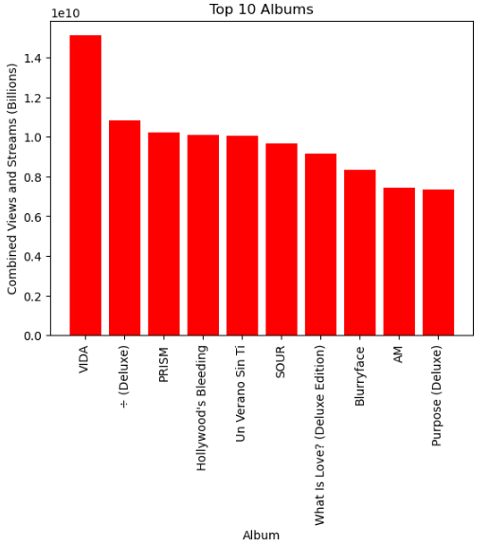
Top 10 Albums: Bar Chart

Slide 34
Top 10 Albums: Bar Chart
Challenges:
Has album name, but not artist name.
When grouping by Album, lost the Artist column.

Slide 35
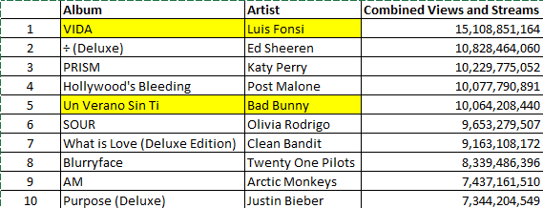
Top 10 Albums: Vlookup Table
Insight: Two albums are Spanish - speaking, by Bad Bunny & Luis Fonsi while rest is English-speaking.
Further Analysis: Would like to compare to top ten albums sold, Soundscan dataset or Billboard.

Slide 36

Single Vs Album - Which is more successful?
Backtracking a bit, what constitutes as success?
The overall top 100 singles & albums then can be used to
determine which track origin is more successful.

Slide 37

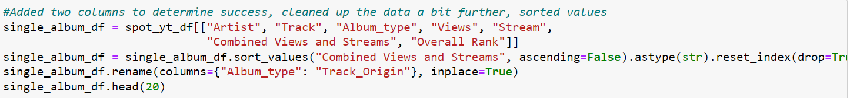
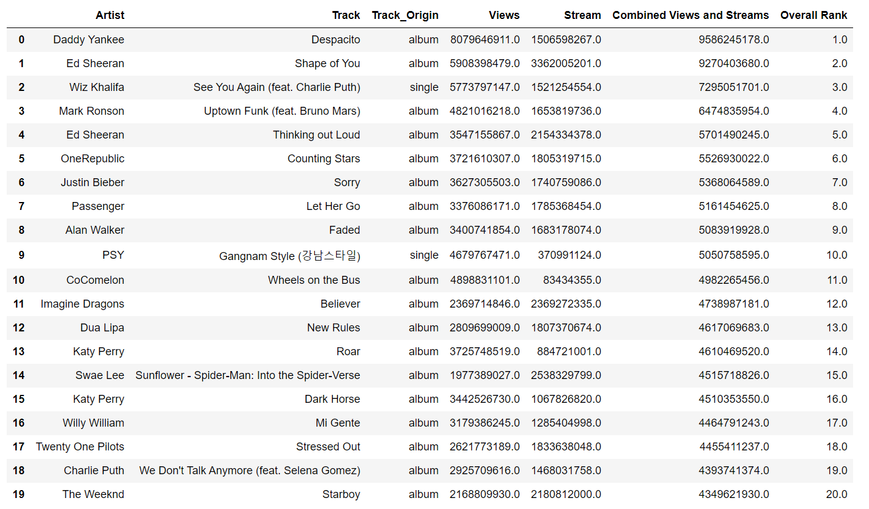
Single Vs Album Success - The Approach
First I created my own separate dataframe from the original
Cleaned the data further.
The output of all the cleaning
and sorting.

Slide 38
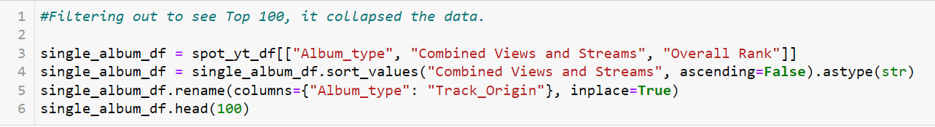
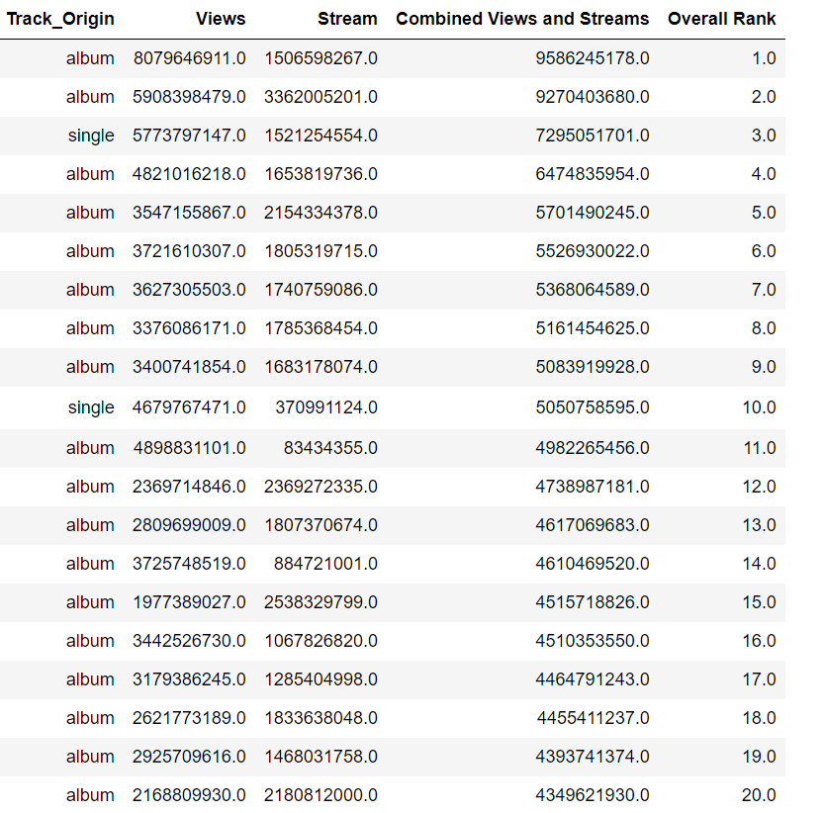
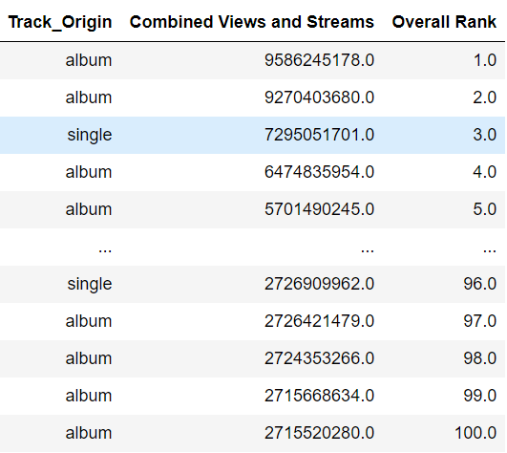

Single Vs Album Success - Filtering
Filtering for Top 100 single/album
Output:
Expanded

Slide 39
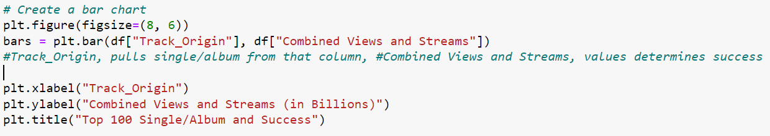
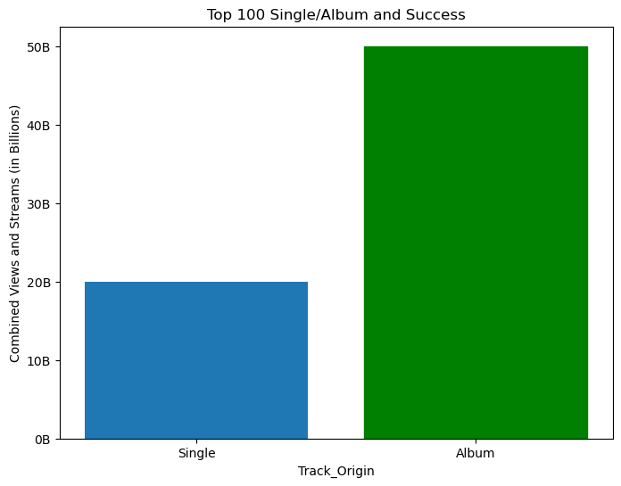
Single Vs Album Success - The Visualization
Bar Chart to Visualize the data
Analysis:
Blue - Collective Sum of all Single Combined Views &
Streams
Green - Collective Sum of all Album Combined Views
& Streams.
Conclusion:
Albums are more successful
30 billion more Combined Views & Streams
More than double the cumulative
Single amount.
Challenge: filtering out the data set,
This data shows the collective summation and not individual
contribution, which would require further cleaning and plotting.

Slide 40

Official Song and Unofficial Song on Youtube
What is the ratio of success between Official and Unofficial Youtube Video song out of Top 100 Songs?
Video that is not uploaded by Artist himself or doesn’t have recording label is Unofficial Video song.
Cleaned the data by renaming columns and sorting it in descending order by Youtube Views, and visualized it using bar chart.

Slide 41
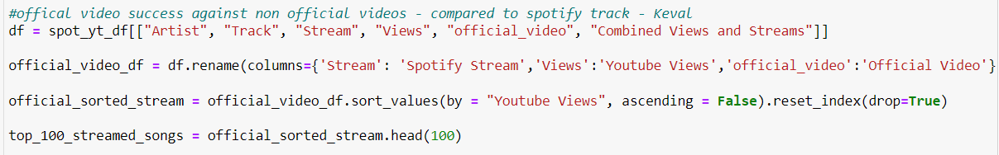
Official Song and Unofficial Song: Cleaning
Cleaned the data by renaming the columns, sorting values in descending order and getting top 100 songs.

Slide 42
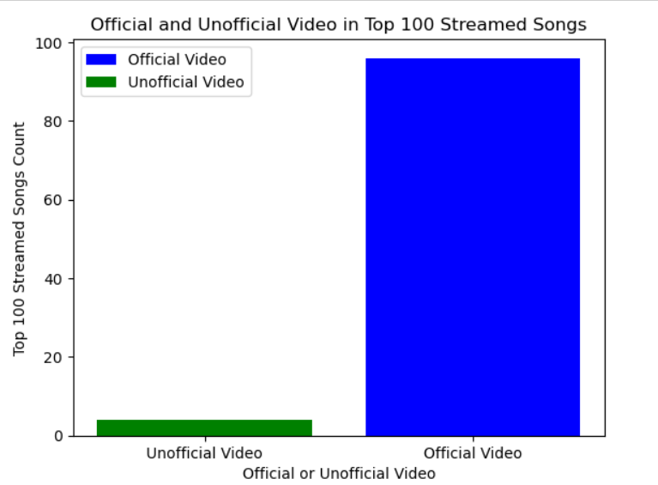
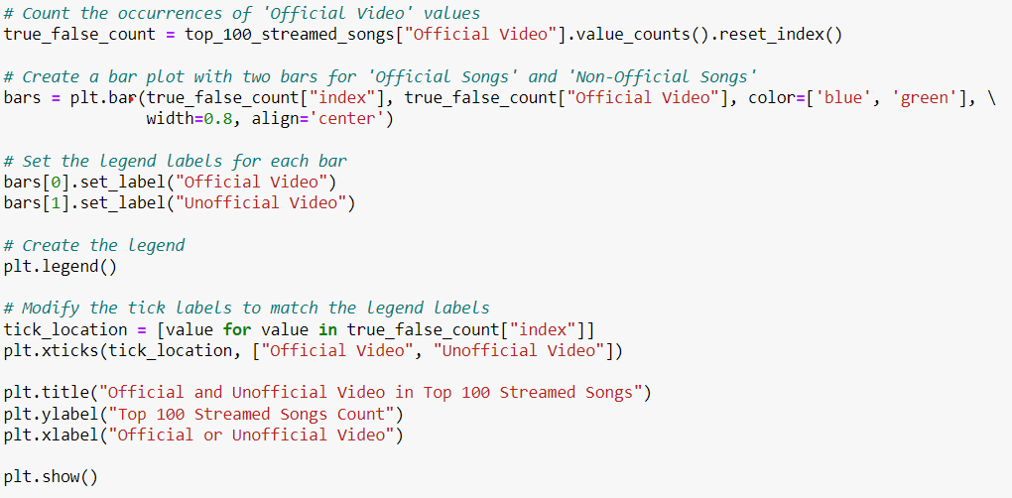
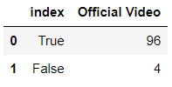
Official Song and Unofficial Song: Visualizing
Created a bar chart to display the data.
Since it was True-False column, used value__counts to get the data.
Conclusion: The ratio of official songs to unofficial song is 25:1.

Slide 43
Licensed Song Vs. Unlicensed Song
Similar to the previous analysis, we also ran analysis for Licensed and Unlicensed songs.
Licensed song means it is copyrighted song.
Unlicensed song means the music is in the public domain and as it is not subject to copyright laws.
Approach was similar to the previous one. Cleaned the data and Visualized using bar chart.

Slide 44
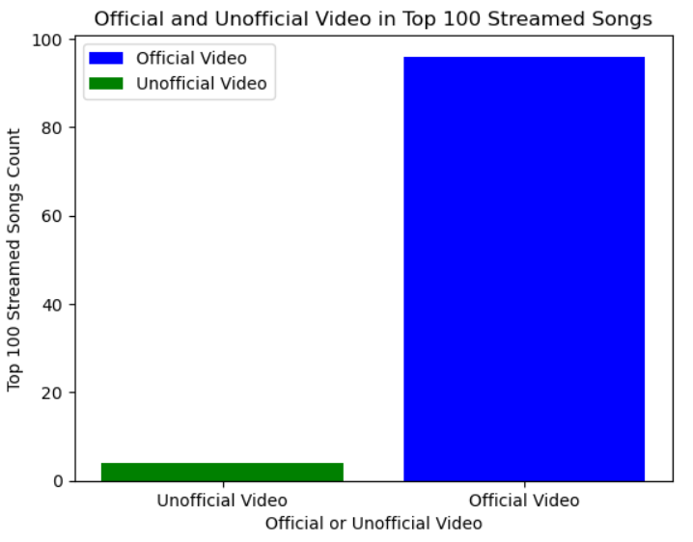
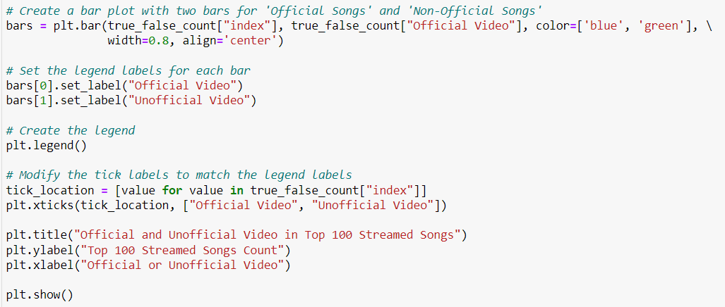
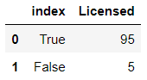
Licensed Song Vs. Unlicensed Song: Visualizing
The outcome is almost similar to the previous one. The only difference is this data has been pulled from spotify and youtube combined.
The ratio of success for Unlicensed songs is 1:20
Challenges: Hard to trace the link between Unofficial Videos in previous analysis and Unofficial Songs. Are Unofficial Songs also Unlicensed?

Slide 45
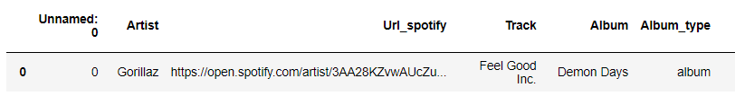
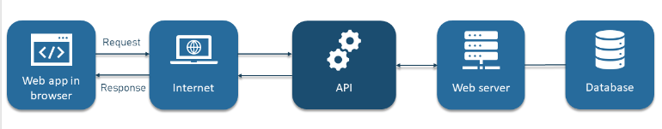
API: Followers and Spotify Stream by Artist
Is there any correlation between artist’s followers and artist’s total stream count on Spotify?
Are the top followed artists on Spotify also the most listened artists on Spotify?
Followers count was not available on dataset, so we used artist ID from URL given in dataset to get followers data from Spotify API.
Used Bar chart to compare.

Slide 46

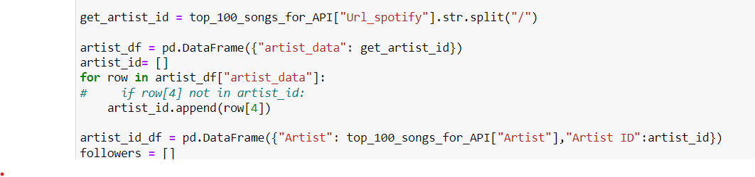
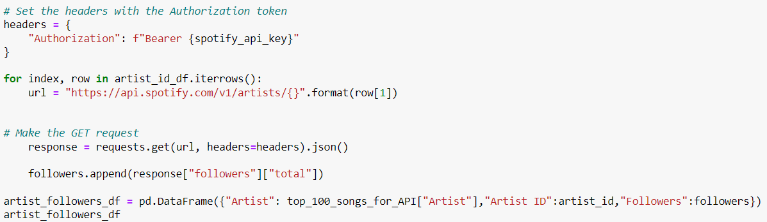
API: Followers and Spotify Stream by Artist: Cleaning
Filtered top 100 songs on Spotify.
Split URL column to get ID and appended it to the empty list.
Using the Artist ID, appended followers count to new empty list and created DataFrame off of that.

Slide 47
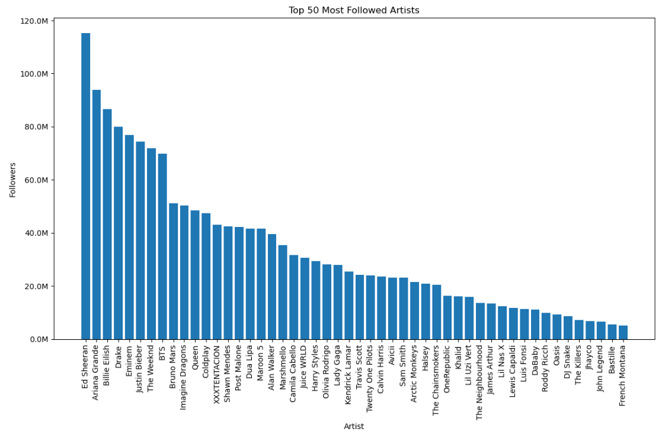
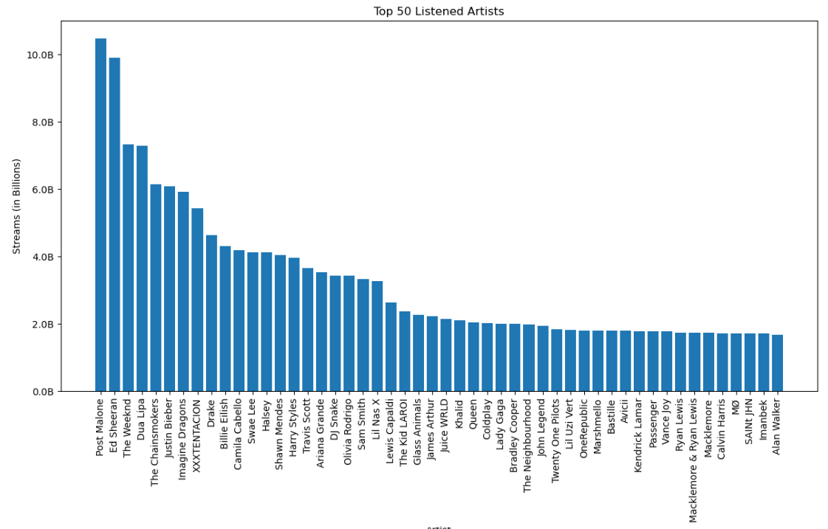
API: Followers and Spotify Stream by Artist: Visualizing
Top 50 Most Followed Artists on Spotify
Top 50 Listened Artists on Spotify
Insight: Only Edsheeran from top 5 most followed artists made it to top 5 most listened artists.

Slide 48
API: Followers and Spotify Stream by Artist: Conclusion
Conclusion: Around 80% Artists that are most followed on Spotify has also the most number of Streams on Spotify. There is a strong correlation between followers count of artists and top streaming artists. Although, as you go down the order of top followers list, the correlation starts to break as mostly artists ranked in top 25 from the followers list made it to top listened artists ranking.
Limitation: The followers data is from Spotify only. It would be interesting to know most followed artists across all social media platforms. Probably rest of the 20% of most listened artists have better social media following on other platforms.
Challenge: The most challenging and interesting part was to use the api from spotify artist link given in dataset. It would have been even better if the API had data for genre in track id endpoint.

Slide 49
THANKS

